Slide 1
computer engineering
Department

Slide 2
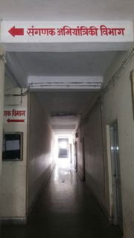
Department of computer engineering

Slide 3
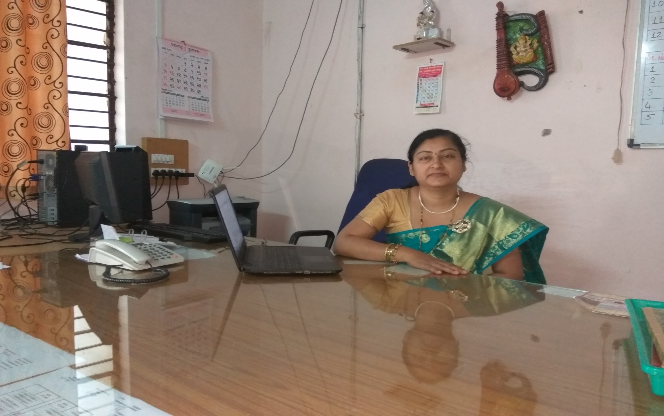
Hod mrs. J. r. hange

Slide 4
Admission status
I - YEAR |  |  | II - Year |  |  |  |  | III - Year
Enrolled | Re-Admitted | Total | Enrolled | Direct | Re-Admitted | Change Branch | Total | Enrolled | Re-Admitted | Total
63 | 0 | 63 | 55 | 17 | 02 | 03 | 77 | 65 | 1 | 66

Slide 5
Examination Summer 2016
Sr.no | Year & Course code | First class with Distinction | First Class | Second class | ATKT | Fail | Total
1 | CO2G | 15 | 10 | 12 | 10 | 14 | 61
2 | CO4G | 27 | 24 | 16 | 04 | 03 | 74
3 | CO6G | 54 | 06 | 02 | Nill | 01 | 63
Examination Winter 2016
Sr.no | Year & Course code | First class with Distinction | First Class | Second class | ATKT | Fail | Total
1 | CO1G | 18 | 11 | 24 | 06 | 4 | 63
2 | CO3G | 18 | 11 | 06 | 16 | 24 | 75
3 | CO5G | 32 | 21 | 07 | 05 | 1 | 75

Slide 6
Strength of department
Regular HOD and Regular faculty staff fulfilled as per AICTE norms.
All faculties are holding Post Graduation higher degree like M-tech / ME related to discipline.
Department has five well equipped labs as per AICTE norms.
Very good academic result of winter 2016 of all classes i.e. 94% -98% is an average.
Student from CO5G & CO3G got out of marks in JPR and AMT respectively.
Got General championship in IEDSS 2017 at Pune, credit goes to Computer department’s participant of Kho-Kho, Kabbadi, Running sports winners.
Total six expert lectures and three MOU’s completed by computer department within academic year 2016-27.
Total Three Industrial Visits arranged in academic year 2016-17.
Most of the faculty deputed for Training / Workshops/ Curriculum development programed.
College Web-site designed and developed under the coordination of computer department.
Prerequisite knowledge based classes arranged for direct second year students.
Students of CO6G Winner and Best performance in Virtual Campus Recruitment Process [VCRP] at Sandipani Technical Institute, Kolpa.

Slide 7
Weakness of department
Posts of Technical Lab assistants are not fulfilled as per AICTE norms.
Minimum three posts of regular teaching staff required as per Students Strength.

Slide 8
Faculty Strength
Sr. No | Particulars | Required as per AICTE / PCI and MSBTE Norms | Filled posts
1 | HOD | 1 | 1
2 | Lecturers (Regular) | 7 | 5
 | Lecturers (contract) |  | 0
 | Lecturers (visiting) |  | 4

Slide 9
Faculty
Sr. No | Name | Qualification | Experience in Yrs.
1 | Mrs. Hange J R | ME- CSE | 22
2 | Mr. Chavan S V | ME- CSE | 27
3 | Ms. R. D. Kasar | M-Tech CSE | 13
4 | Mr. S. V. Kendre | M-Tech CSE | 11
5 | Ms. M. G. Mulge | M-Tech CSE | 11
6 | Mrs. Patil A S | ME- CSE | 05
7 | Mr. R. B. Salunke | BE-CSE | 03
8 | Mr. Kulkarni K K | BE-CSE | 03
9 | Ms. Shastri A. J | ME-Appeared | 02
10 | Ms. Pawar P A | ME- Electrical | 02

Slide 10
Lab assistant
Sr. No | Name | Qualification | Experience in Years.
1 | Mr. A. R Dharmadhikari | COPA, BA | 22
3 | Ms. N. D. Hishobe | Diploma in IT | 22

Slide 11
Laboratory
Sr. No | Name of Lab | No of Major Equipments | Cost
1 | INTERNET LAB | PC-IV 20, LCD PROJECTOR , UPS | 585456
2 | PROGRAMMING LAB | PC-IV 16, UPS , LCD PROJECTOR | 848047
3 | O.S. LAB | PC-IV 17, UPS | 1091670
4 | NETWORK LAB | PC-IV 16 | 686997
5 | HARDWARE LAB | MICROPROCESSOR KITS, PRINTERS | 314317

Slide 12
Result Analysis – 2016-17
Class | Total | Clear | Failed | ATKT | % Passing
CO1G | 63 | 53 | 4 | 6 | 84.14%
CO3G | 75 | 35 | 16 | 24 | 78.66%
CO5G | 66 | 60 | 1 | 5 | 98.48%

Slide 13
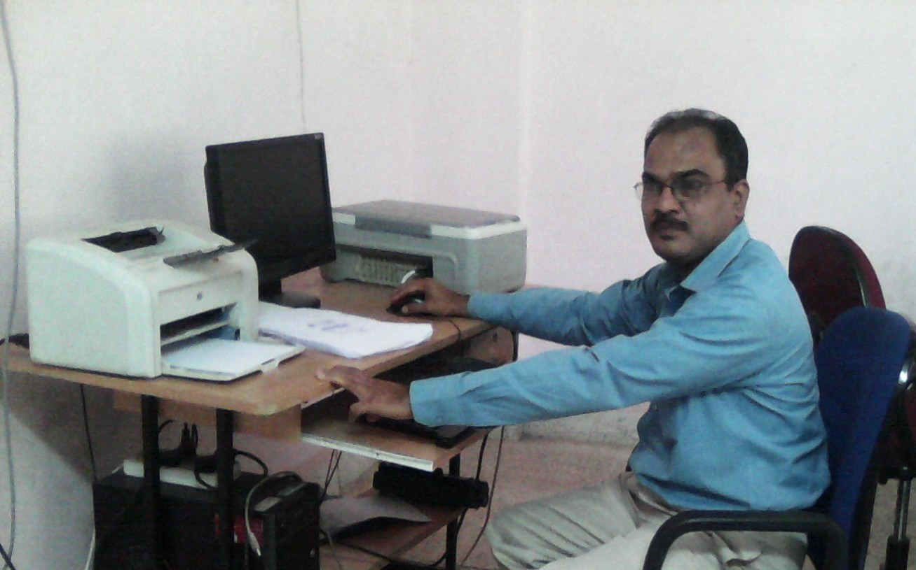
Lab Assistant mr. a r dharmadhikari

Slide 14
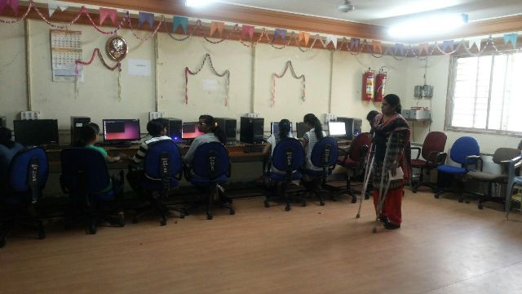
Internet Lab -1

Slide 15
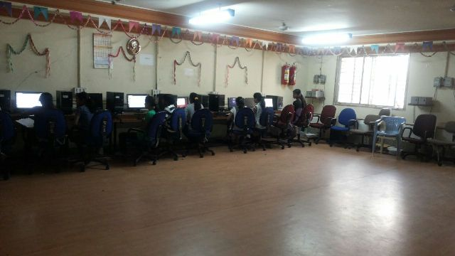

Slide 16
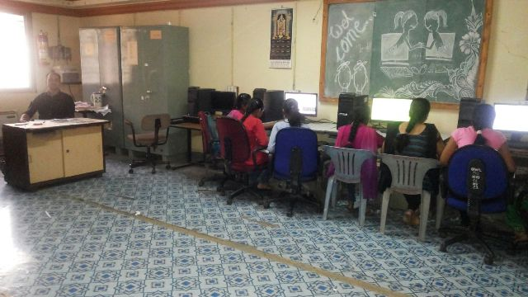
Software Lab -2

Slide 17
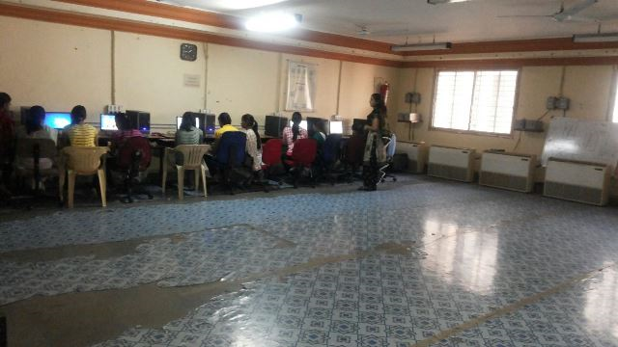

Slide 18
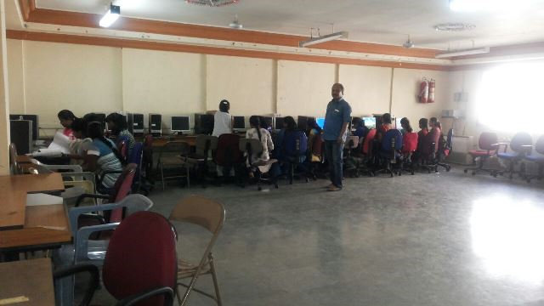
OS lab -3

Slide 19
NETWORK LAB -5

Slide 20
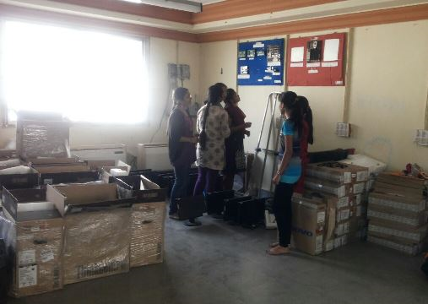
Hardware lab

Slide 21
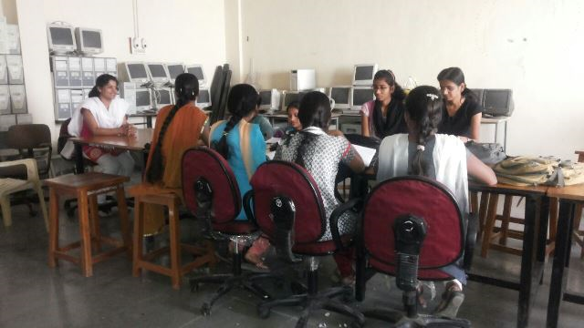
COMPUTER LAB

Slide 22
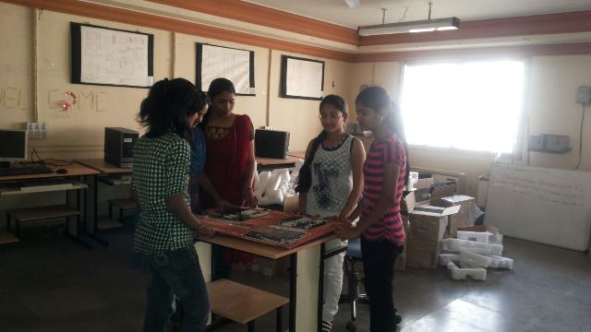
h/w lab -6 : motherboard observation

Slide 23
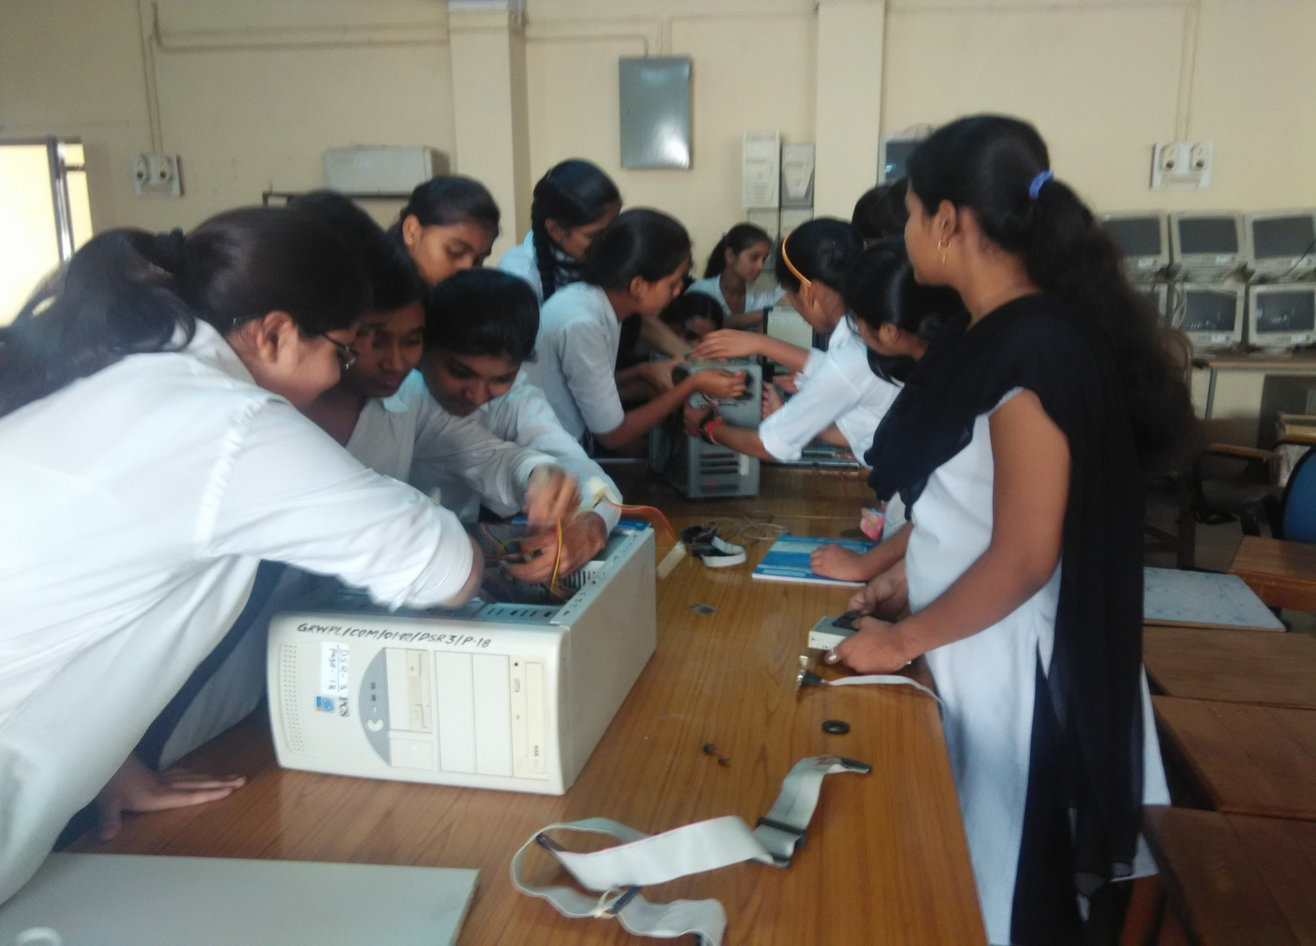
COMPUTER H/W LAB

Slide 24
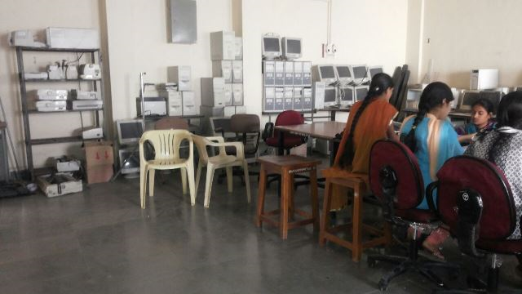

Slide 25
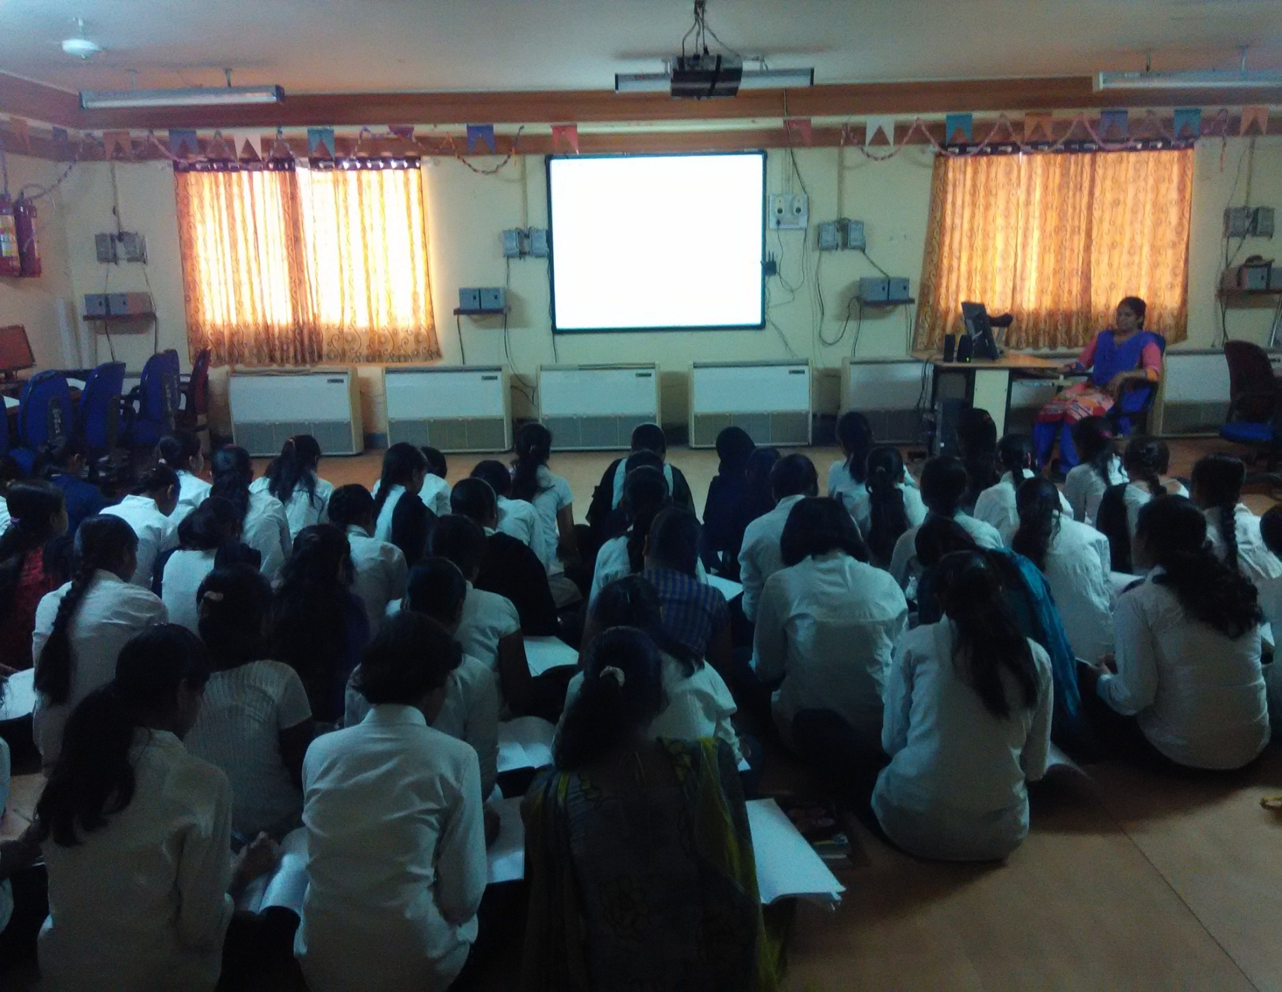
Digital classroom

Slide 26
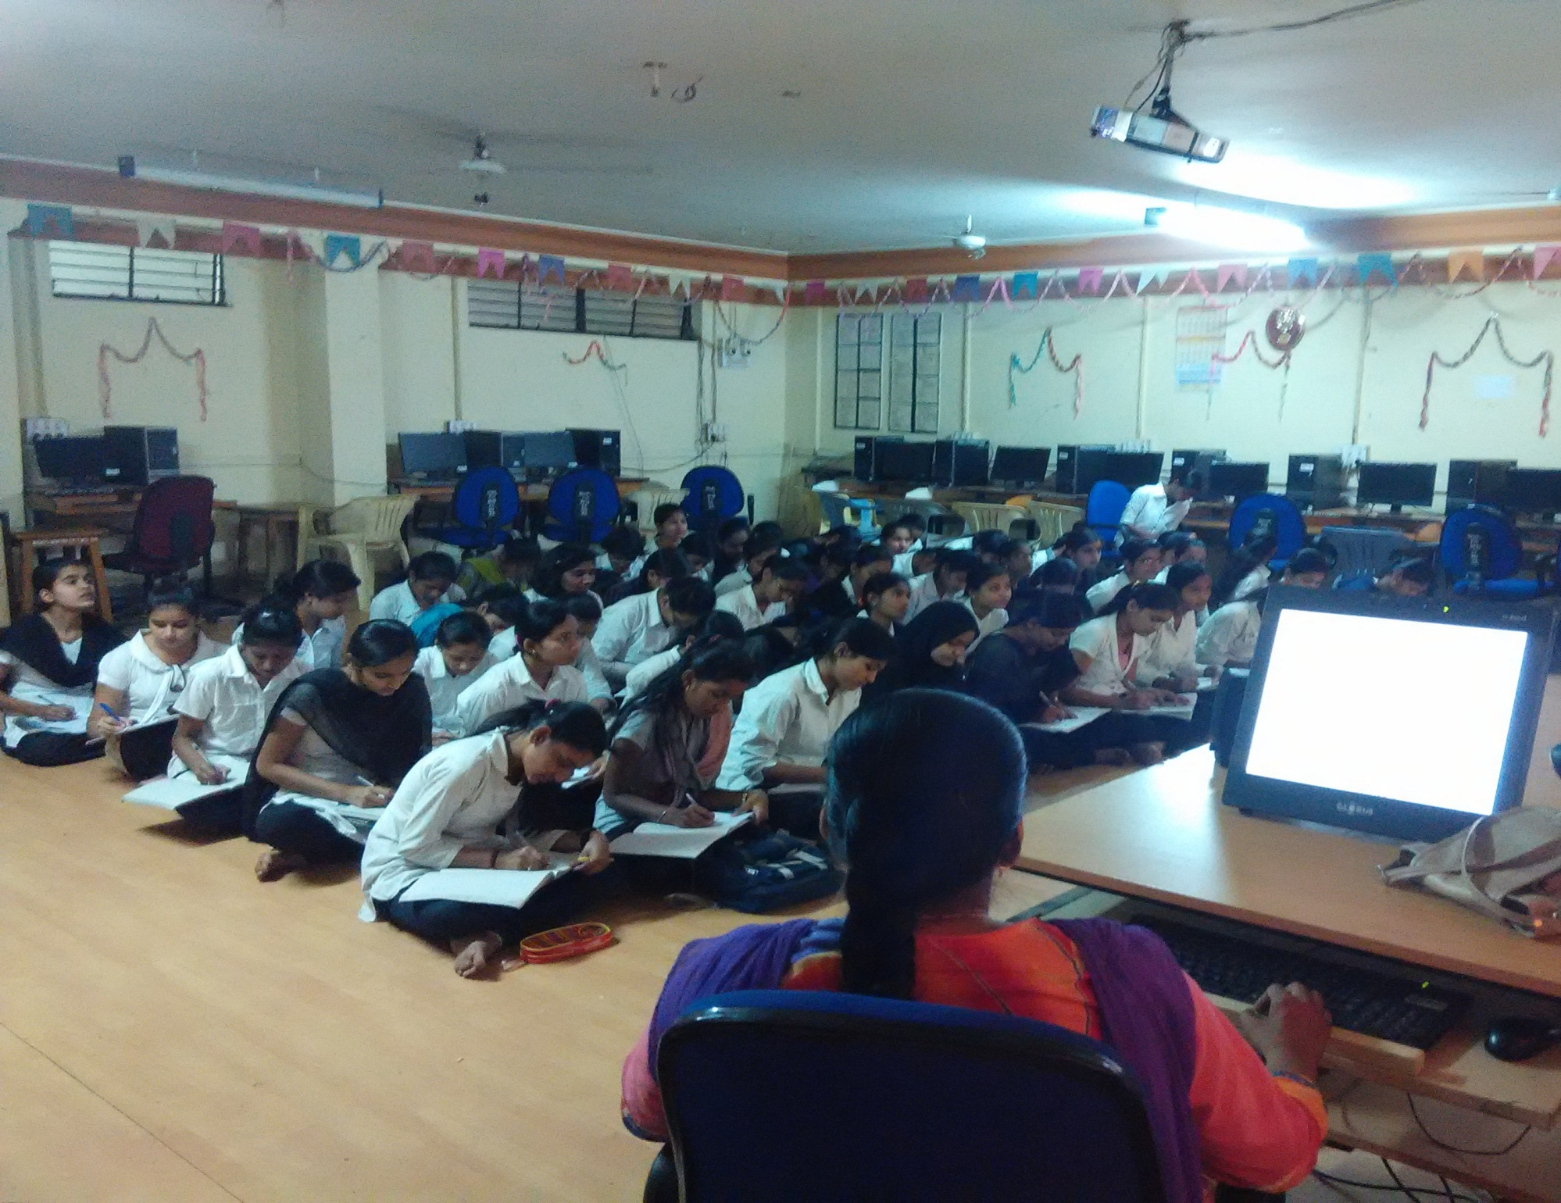

Slide 27
FACULTY TRAINING DEPUTATIONS
Sr. No | Name of staff completed Training in Previous Academic Year 2015-16 and 2016-17
 | Name of the Staff | Training / Workshop / Content Updating | Venue/ Place | Any Other
01 | Mr. S V Chavan | G P Nanded [2 weeks] | EDP
 |  | MSBEC ISTE [2 weeks] | Information to Research Methodology
 |  | MSBEC ISTE [2 weeks] | DBMS
 |  | Govt Residential Women’s Polytechnic latur 4/01/2016 to 9/01/2016 | Workshop on Matlab Simulation and Programming
02 | Mr. S V Kendre | NIITTR, Pune 18/06/2012 to 22/06/2012 | Staff Development Program Management of CDTP scheme , Phase –I
 |  | NIITTR, Pune 02/06/2014 to 06/06/2014 | Staff Development Program Management of CDTP scheme, Phase II
 |  | MCE Society Institution of Pharmacy 23/6/2014 to 04/7/2014 | Induction, Phase -I
 |  | Yashada Pune 29/07/2013 to 07/09/2013 | Foundation course , Phase I, II, III
 |  | NIITTR, Bhopal 12/01/2015 to 23/01/2015 | Staff Development Program Management of CDTP scheme, Phase II
 |  | Govt Engineering Karad 19/12/2015 to 23/12/2015 | HADOP workshop
03 | Ms. R D Kasar | AICTE Recognized Short Term Course 7/10/2013 to 11/10/2013 | Linux Server Administration
 |  | AICTE Recognized 03/03/2014 to 07/03/2014 | Personality Development Through Positive Thinking
04 | Ms. M G Mulge | Govt Residential Women’s Polytechnic latur 4/01/2016 to 9/01/2016 | Workshop on Matlab Simulation and Programming
05 | Mr. S. L Salunke, Tech.Lab Asst. | Maharashtra Prashaskiya prabodhini, Paithan ( Jan.2016) | Refresher Training prgoramme.

Slide 28
FACULTY TRAINING DEPUTATIONS
Sr. No | Name of staff completed Training in Previous Academic Year 2015-16 and 2016-17
 | Name of the Staff | Training / Workshop / Content Updating | Venue/ Place | Any Other
06 | Ms. M G Mulge | “ Basic Chemicals in nano Technology” Duration 23/05/2016 to 28/05/2016 one week | Govt. Engineering college of Karad
 |  | Phase – I Induction Training program for faculty development by NITTTR Bhopal duration 30/5/2016 to 10/06/2016 Two weeks | CMASS Engineering college of Aurangabad, Paithan Road
07 | Mrs. J R Hange HOD of Computer Department | " Outcome Based Education (OBE0 Philosophy and NBA Awareness" Duration 9/01/2017 to 13/01/2017 | Sponserd by DTE at G P Pune
 |  | "Curriculum Revision Workshop” Duration 12/01/16 to 14/01/16 | at NITTTR , extenssion Center Pune
 |  | Personality Development" Duration 12/2/2016 | at G.P. Pune
 |  | " Orientation Training on Learning Management System (LMS0 ) for e-Learning Duration 29/12/2016 to 31/12/2016 | At YASHADA Pune
 |  | First Course detailing Workshop for 1st group Third Semester Program 8/11/2016 to 10/11/2016 | at NITTTR, Extension Center Pune Duration
09 | Ms. R D Kasar | Lecturer Computer Engineering attended TEQIP " Pedagogy toSynergogy -An Innovative Statargy for Progressive Education " | At Govt. Engi. Jalgaon
 |  | Lecture Computer Engineering Attended " BEST- Basic Employability skill Training " Duration 23/01/2017 to 3/2/2017 | at NITTTR Bhopal
10 | Mrs. Patil A S | Lecturer Computer Engi. Dept. attended Workshop " Biology for Engineers 9/1/2017 to 13/1/2017 | " at COEP Pune Duration

Slide 29
INDUSTRIAL VISITS
Sr. No | Name of Industry | Address Contact Details | Semester | Subject Name | Name of Staff to be involved
1 | BSNL - Bharat Sanchar Nigam Limited Latur | BSNL office, Gandhi Chowk Latur- 413512 | CO6G | PPO | Mr. R D Kasar, Mr. R B Salunke , Ms. A J Shashtri
2 | Arty offset industries Latur | MIDC area, Hadco Latur - 413531 | CO4G | PPT | Mrs. A. S Patil, Mr. A R. Dharmadhikari
3 | Oriange IT Services Pvt. Ltd. Latur | Near Water Tank, Barshi Road Latur - 413531 | CO5G | Industrial Visit [IPR] | Ms. R D Kasar, Mrs. A S Patil

Slide 30
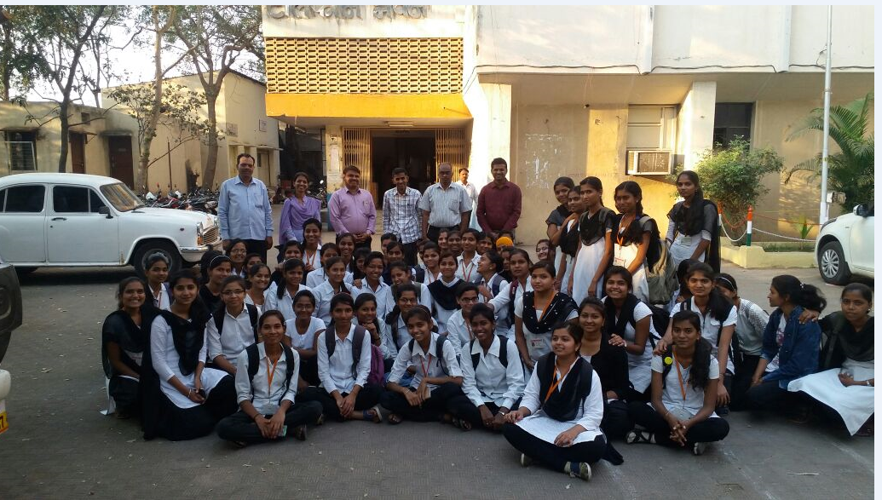
Visit at BSNL Latur

Slide 31
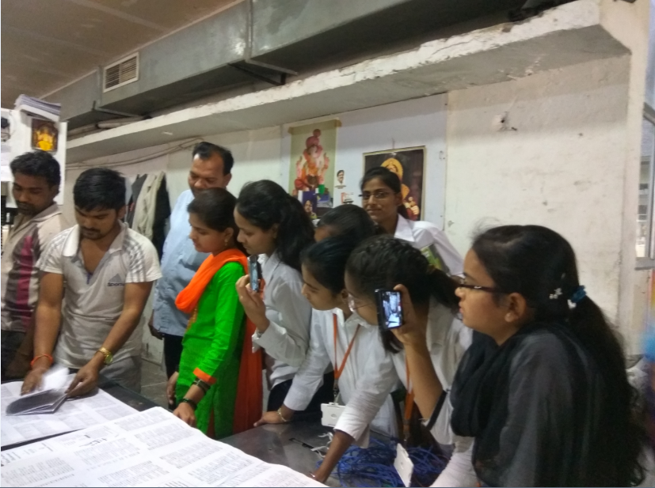
Arty offset Printing Technology

Slide 32
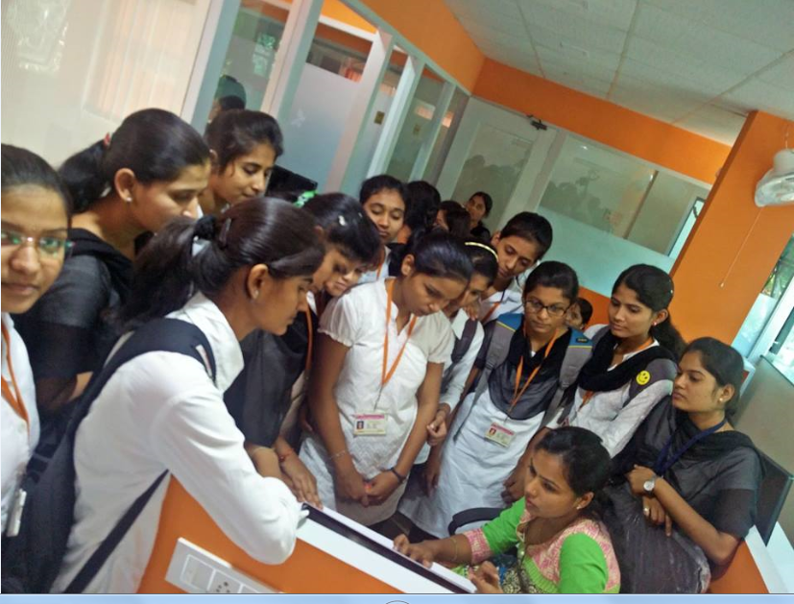
Oriange Pvt Ltd. Latur

Slide 33
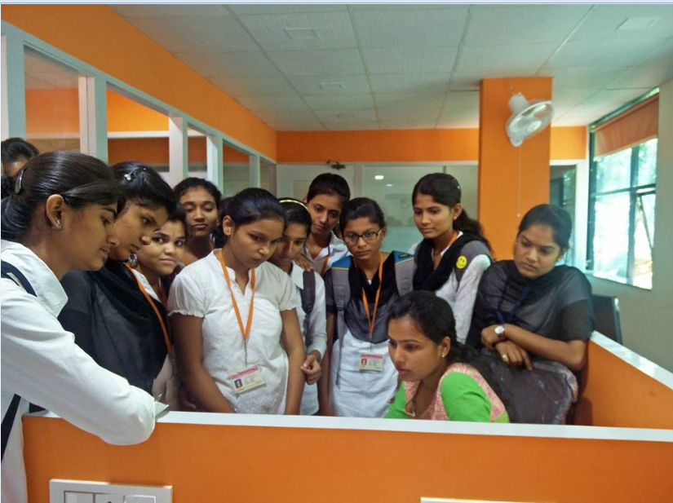

Slide 34
Expert lectures: list
Sr. No | Name of Expert Contact Details | Topic | Subject | Semester | Name of Inviting Faculty
1 | Mrs. Swami Varsha VA³ IT Services Pvt. Ltd. Latur- 413531 | Eithical Hacking | Computer Security | CO5G | Ms. M G Mulge, Ms. A S Patil
 |  | Cloud Computing | Database Management system | CO3G
2 | Sonali A Mustare Synechis Aquilam Solutions Pvt. Ltd. Pune | Awareness about IT Technologies | Operating system | CO5G | Ms. M G Mulge, Ms. A S Patil
 |  |  | Programming Laguages | CO3G
3 | Abhijeet A. More CYIN Solutions Pvt. Ltd. Pune | Internet Security | Software Testing and Security | CO6G | Ms. M G Mulge, Ms. R D Kasar
 |  |  |  | CO4G
4 | Mr. Ganesh STEP- Software Technologies Excellence Program, Hyderabad - 500032 | Thought Works | EDP | CO6G | Mr. S V Chavan, Mr. S V kendre

Slide 35
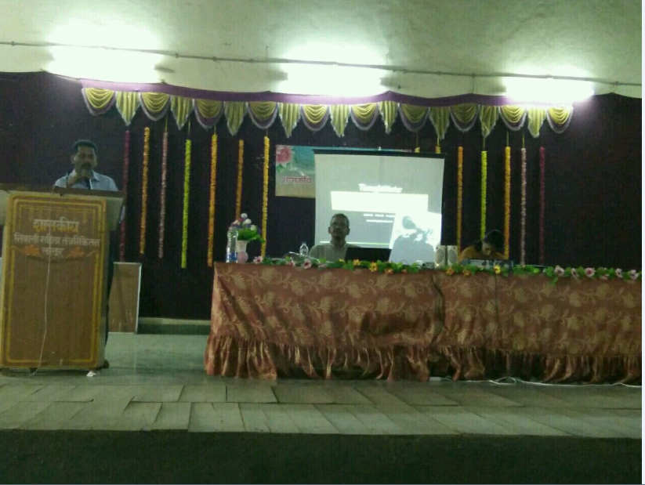

Slide 36
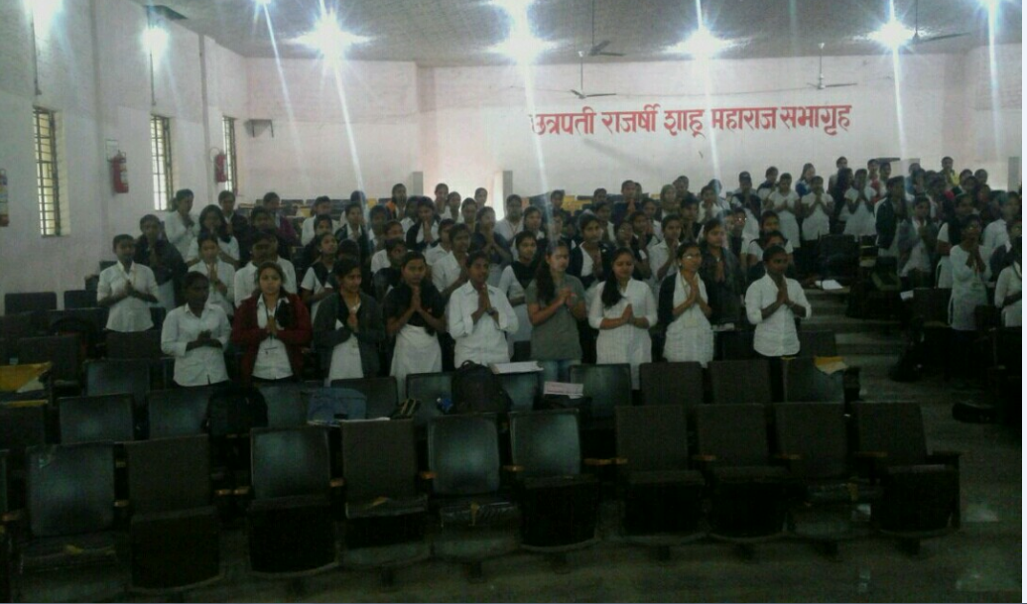

Slide 37
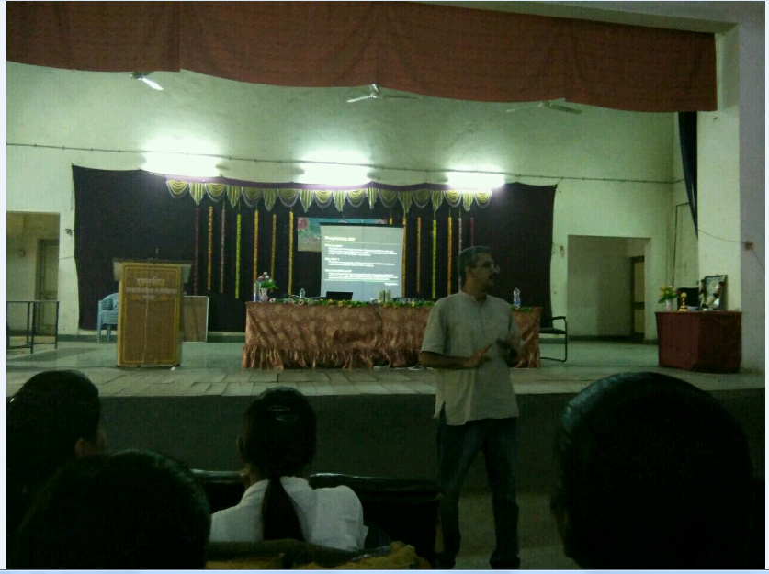

Slide 38
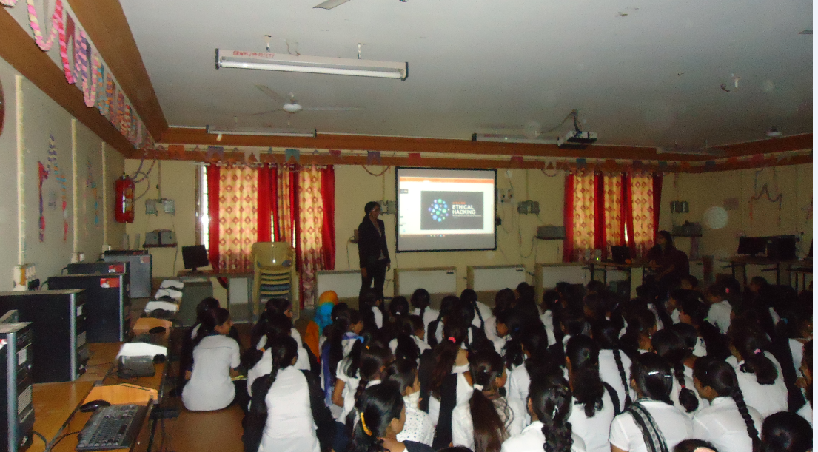
Varsha Swami , Director of Oriange Pvt. Ltd . Latur

Slide 39
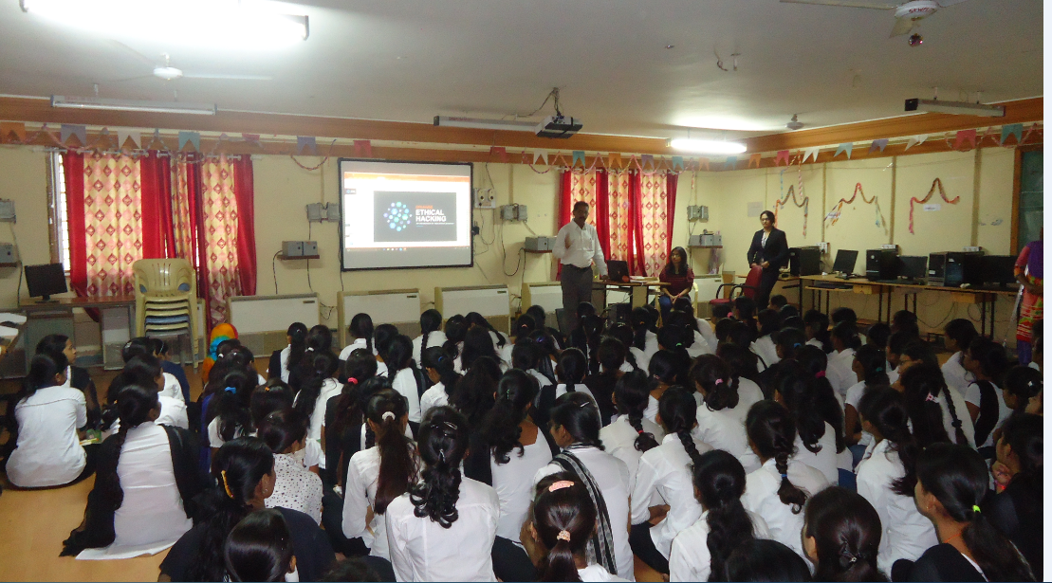

Slide 40
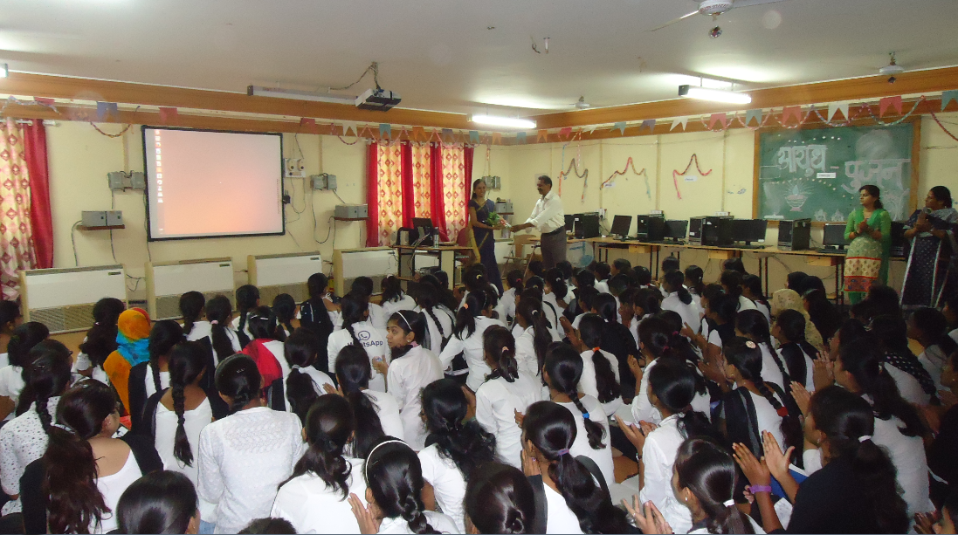

Slide 41
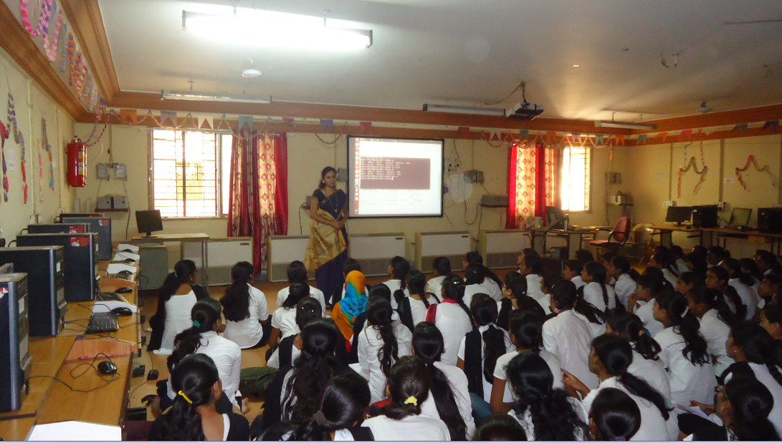
sOnali Hanche , Director of Synosis Equalim Pvt Ltd, Pune

Slide 42
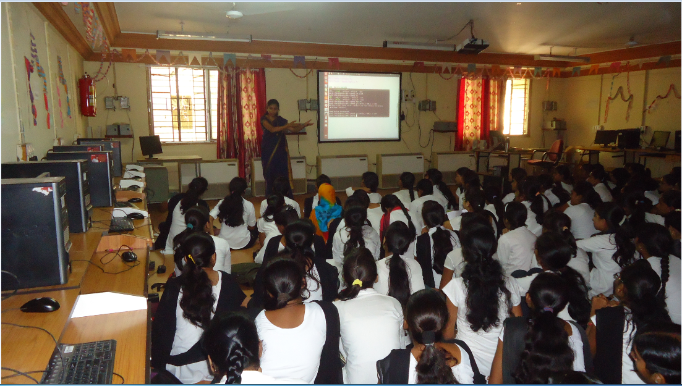

Slide 43
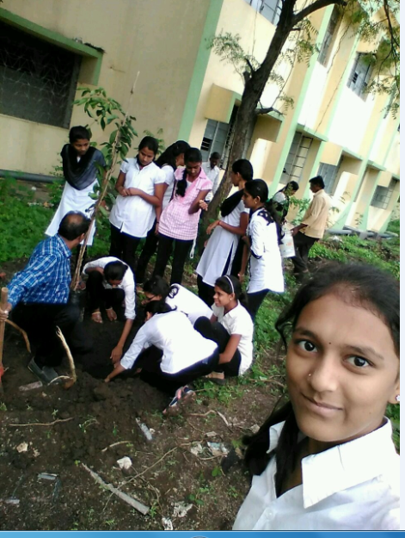
Tree Plantations

Slide 44
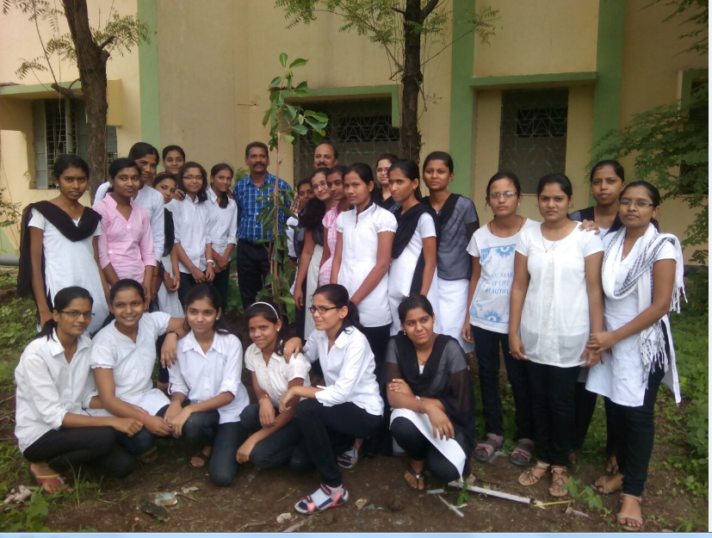

Slide 45
AchievementS in INTER ENGINEERING DIPLOMA STATE LEVEL SPORTS FOR GIRLS -2017 pune

Slide 46
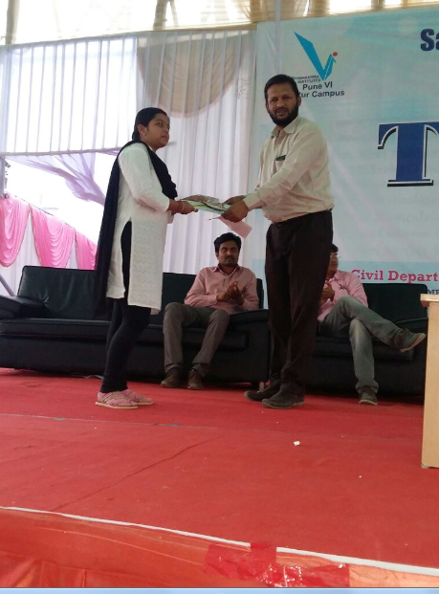
Kajal Budruk Students of CO6G Winner
and
More M. Mayuri is the Best performance achivers
in Virtual Campus Recruitment Process [VCRP] at Sandipani Technical Institute,
Kolpa.

Slide 47
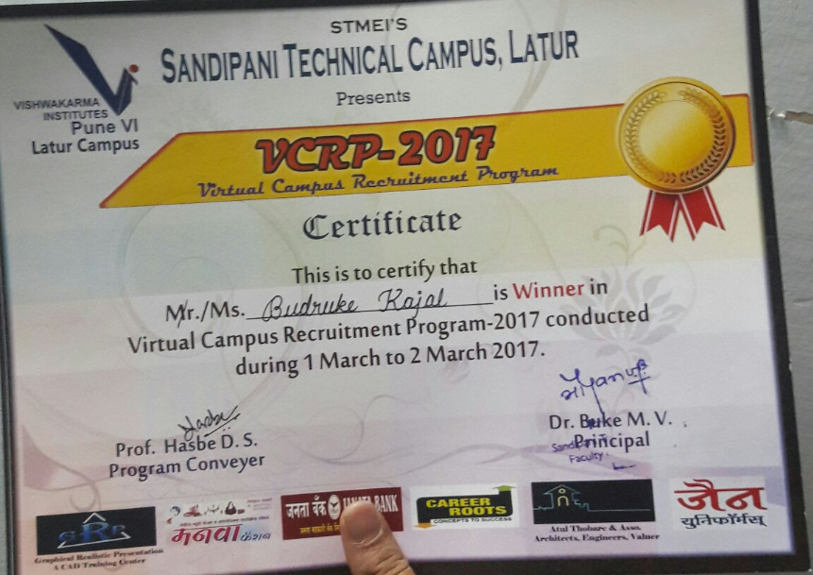

Slide 48
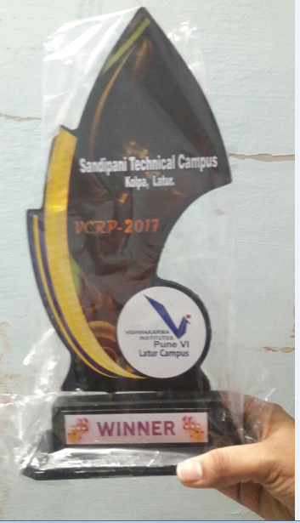

Slide 49
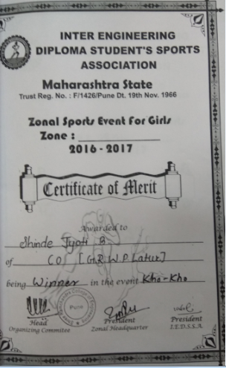
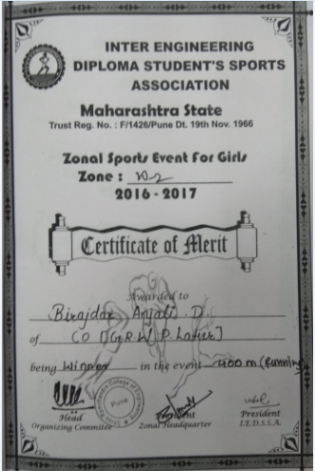
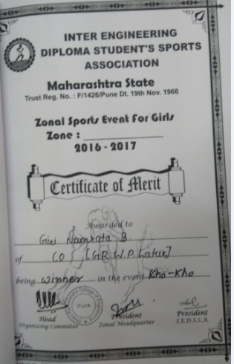

Slide 50
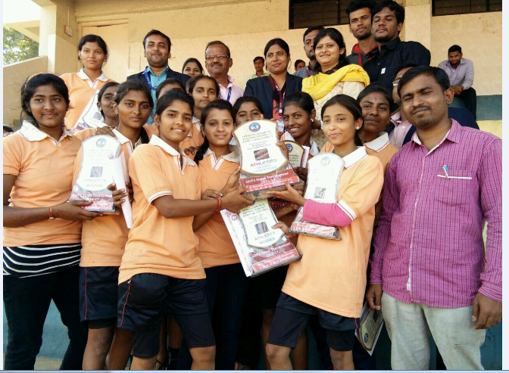

Slide 51
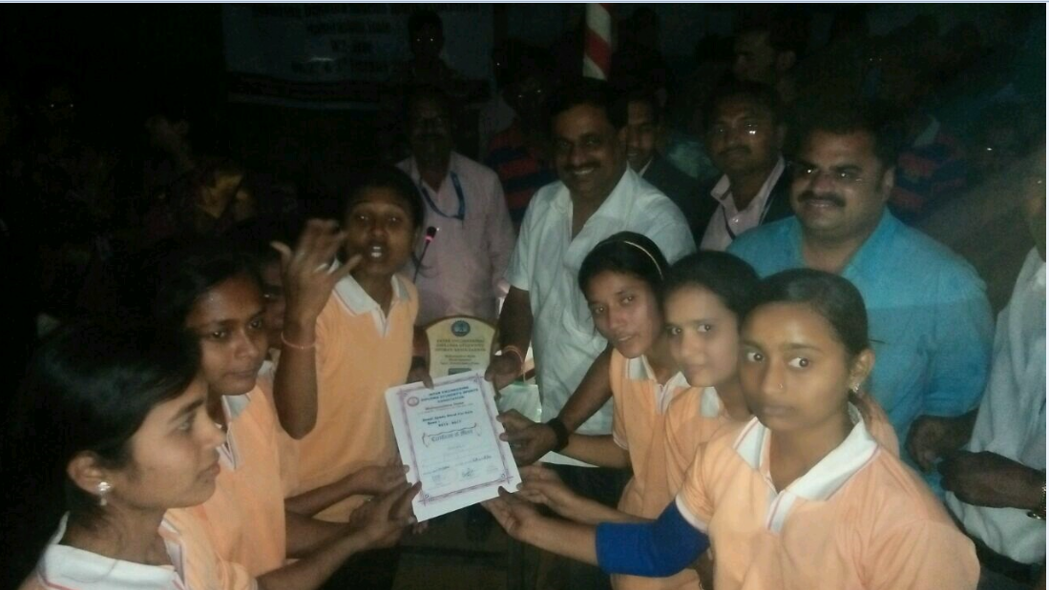

Slide 52
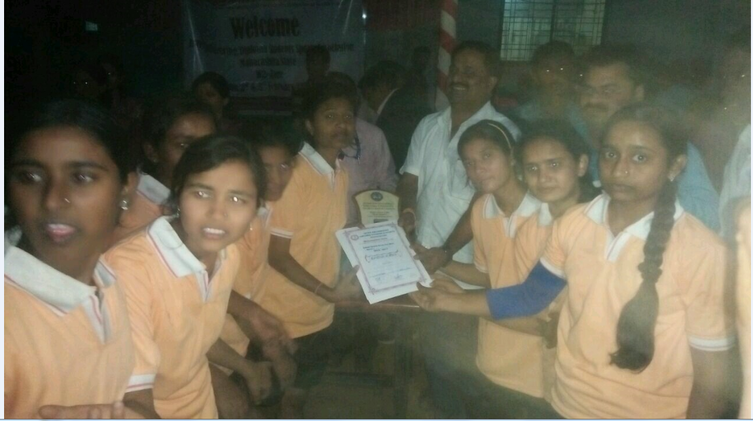

Slide 53
Thanks….

